Slide 1
Chapter 4
Bottom Up Parsing

Slide 2
Right Sentential Forms
E -> E+T
E -> T
T -> T*F
E -> F
F -> (E)
F -> id
Recall the definition of a derivation and a rightmost derivation.
Each of the lines is a (right) sentential form
The parsing problem is finding the correct RHS in a right-sentential form to reduce to get the previous right-sentential form in the derivation
  E
  E+T
  E+T*F
  E+T*id
  E+F*id
  E+id*id
  T+id*id
  F+id*id
  id+id*id
generation
parsing

Slide 3

Shift-Reduce Algorithms
A shift-reduce parser scans input, at each step, considers whether to:
Shift the next token to the top of the parse stack (along with some state info)
Reduce the stack by POPing several symbols off the stack (& their state info) and PUSHing the corresponding nonterminal (& state info)

Slide 4
Shift-Reduce Algorithms
The stack is always of the form
bottom
top
S1 X1 S2 X2 … Sn Xn
state
terminal or
non-terminal
A reduction step is triggered when we see the symbols corresponding to a rule’s RHS on the top of the stack
bottom
top
S1 X1 …S5 X5 S6 T S7 * S8 F
T -> T*F
S1 X1 …S5 X5 S6’ T

Slide 5
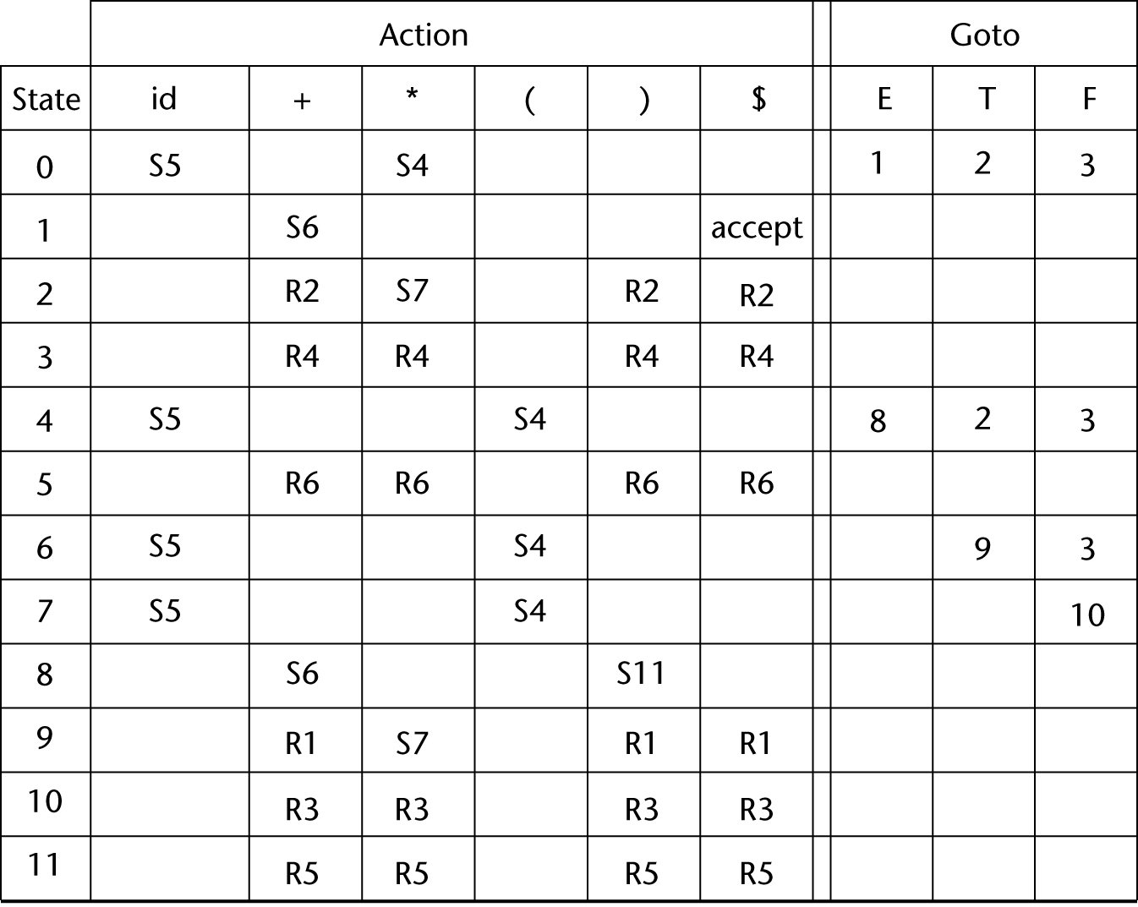
LR parser table
LR shift-reduce parsers can be efficiently implemented by precomputing a table to guide the processing
More on this
Later . . .

Slide 6
When to shift, when to reduce
The key problem in building a shift-reduce parser is deciding whether to shift or to reduce.
  repeat: reduce if you see a handle on the top of the stack, shift otherwise
  Succeed if we stop with only S on the stack and no input
A grammar may not be appropriate for a LR parser because there are conflicts which can not be resolved.
A conflict occurs when the parser cannot decide whether to:
  shift or reduce the top of stack (a shift/reduce conflict), or
  reduce the top of stack using one of two possible productions (a reduce/reduce conflict)
There are several varieties of LR parsers (LR(0), LR(1), SLR and LALR), with differences depending on amount of lookahead and on construction of the parse table.

Slide 7
Conflicts
Shift-reduce conflict: can't decide whether to shift or to reduce
Example : "dangling else"
  Stmt -> if Expr then Stmt
  | if Expr then Stmt else Stmt
  | ...
What to do when else is at the front of the input?
Reduce-reduce conflict: can't decide which of several possible reductions to make
Example :
  Stmt -> id ( params )
  | Expr := Expr
  | ...
  Expr -> id ( params )
Given the input a(i, j) the parser does not know whether it is a procedure call or an array reference.

Slide 8
Handles
Intuition: A handle of a string s is a substring a such that :
  a matches the RHS of a production A -> a; and
  replacing a by the LHS A represents a step in the reverse of a rightmost derivation of s.
Example : Consider the grammar
  S -> aABe
  A -> Abc | b
  B -> d
The rightmost derivation for the input abbcde is
  S => aABe => aAde => aAbcde => abbcde
The string aAbcde can be reduced in two ways:
  (1) aAbcde => aAde; and
  (2) aAbcde => aAbcBe
But (2) isn’t a rightmost derivation, so Abc is the only handle.
Note: the string to the right of a handle will only contain non-terminals (why?)

Slide 9
Phrases, simple phrases and handles
Def: β is the handle of the right sentential form γ = αβw if and only if S =>*rm αAw => αβw
Def: β is a phrase of the right sentential form γ if and only if S =>* γ = α1Aα2 =>+ α1βα2
Def: β is a simple phrase of the right sentential form γ if and only if S =>* γ = α1Aα2 => α1βα2
The handle of a right sentential form is its leftmost simple phrase
Given a parse tree, it is now easy to find the handle
Parsing can be thought of as handle pruning

Slide 10
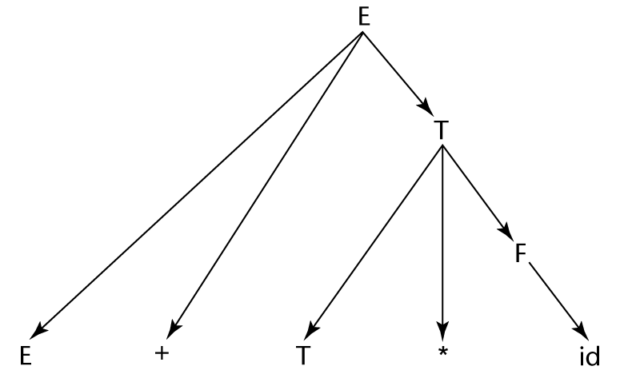
Phrases, simple phrases and handles
E -> E+T
E -> T
T -> T*F
E -> F
F -> (E)
F -> id
  E
  E+T
  E+T*F
  E+T*id
  E+F*id
  E+id*id
  T+id*id
  F+id*id
  id+id*id

Slide 11
LR Table
An LR configuration stores the state of an LR parser
  (S0X1S1X2S2…XmSm, aiai+1…an$)
LR parsers are table driven, where the table has two components, an ACTION table and a GOTO table
The ACTION table specifies the action of the parser (e.g., shift or reduce), given the parser state and the next token
  Rows are state names; columns are terminals
The GOTO table specifies which state to put on top of the parse stack after a reduce
  Rows are state names; columns are nonterminals

Slide 13
Parser actions
Initial configuration: (S0, a1…an$)
Parser actions:
1 If ACTION[Sm, ai] = Shift S, the next configuration is: (S0X1S1X2S2…XmSmaiS, ai+1…an$)
2 If ACTION[Sm, ai] = Reduce A → β and S = GOTO[Sm-r, A], where r = the length of β, the next configuration is
    (S0X1S1X2S2…Xm-rSm-rAS, aiai+1…an$)
3 If ACTION[Sm, ai] = Accept, the parse is complete and no errors were found.
4 If ACTION[Sm, ai] = Error, the parser calls an error-handling routine.

Slide 15
Yacc as a LR parser
0 $accept : E $end
1 E : E '+' T
2 | T
3 T : T '*' F
4 | F
5 F : '(' E ')'
6 | "id"
state 0
$accept : . E $end (0)
'(' shift 1
"id" shift 2
. error
E goto 3
T goto 4
F goto 5
state 1
F : '(' . E ')' (5)
'(' shift 1
"id" shift 2
. error
E goto 6
T goto 4
F goto 5
. . .
The Unix yacc utility is just such a parser.
It does the heavy lifting of computing the table.
To see the table information, use the –v flag when calling yacc, as in
  yacc –v test.y

